Slide 1
CAR DATA ANALYSIS
TEAM MEMBERS:
CHITTAKSH KHADSE
KUNTAL NAPHADE
VIDUSHI DIKSHIT

Slide 2
AGENDA
Predict the most efficient, cheapest vehicle for sale.
Acquire vehicle data from various sources .
To determine the true market value of a used car .

Slide 3
HYPOTHESIS
Prediction of Future Car Price based on :
PRICE- MAKE –YEAR
PRICE-MODEL-YEAR
MAKE-MODEL-YEAR

Slide 4
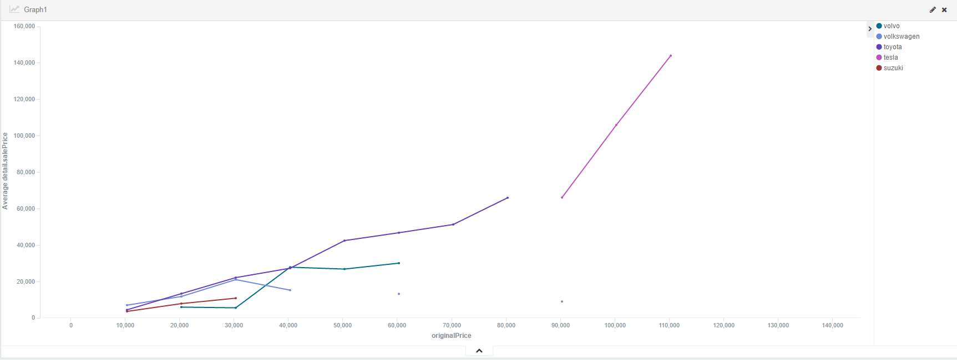
ASSUMPTION

Slide 5
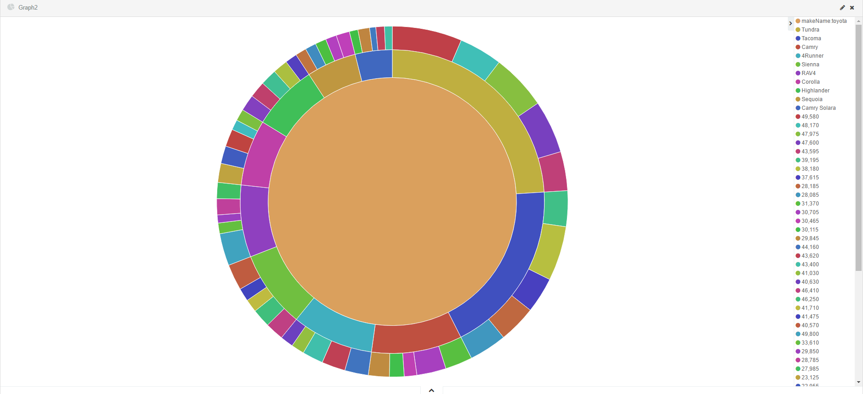

Slide 6
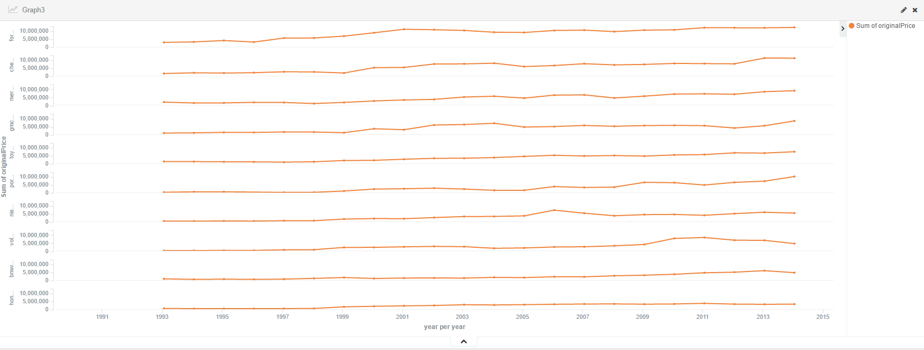

Slide 7
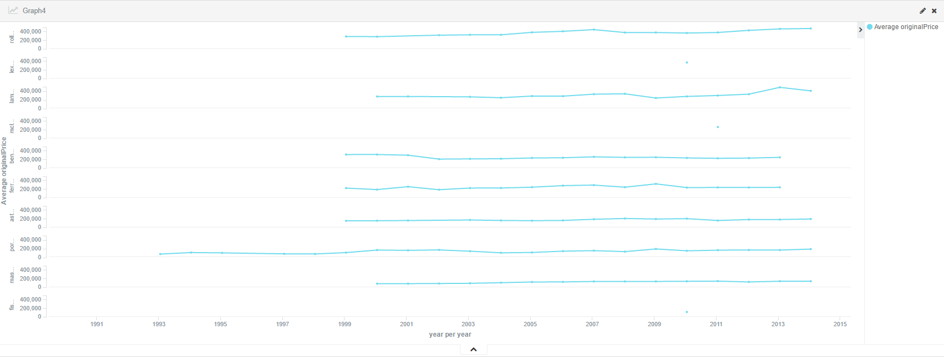

Slide 8
DATA & TOOLS
ElasticSearch & Kibana
For Visualization
Pie Charts
Line Chart Graph

Slide 9
FUTURE ANALYSIS
Crawling more API’s in future can give us more effective data , on which we can make predictions like what features are most needed in a car to make it best selling and more other accurate predictions.
We can also predict the most favorite car in all kinds of categories.
We will also be able to predict useful data for the manufacturers to increase the car sales .

Slide 10
THANK YOU

